Slide 1
Investment Plan for Europe Delivering on the European Fund for Strategic Investments (EFSI)
2015

Slide 2
Investment gap and persisting low growth in Europe
Real GDP per capita (in purchasing-power and inflation adjusted international dollar, 2013)
Estimates of potential growth (in percent)
Source: European Commission, AMECO
Average annual Total Factor Productivity growth (in percent)
Source: IMF, WEO
Source: The Conference Board; EU North = AT, BE, DE, DK, FI, FR, IE, LU, NL, SE, UK; EU South = CY, ES, IT, GR, MA, PT; EU East = BU, CZ, EE, HU, LT, LV, PL, RO, SI, SK

Slide 3
3 ways to tackle the investment gap
Investment Plan for Europe
Mobilise finance for investment
European Fund for Strategic Investments (EFSI)
Cooperation with National Promotional Banks
Support investment in real economy
European Investment Advisory Hub (EIAH)
European Investment Project Portal (EIPP)
Create an investment friendly environment
Improving the regulatory environment
Structural reforms
Aim: to mobilise at least €315 billion in investment across the EU

Slide 4
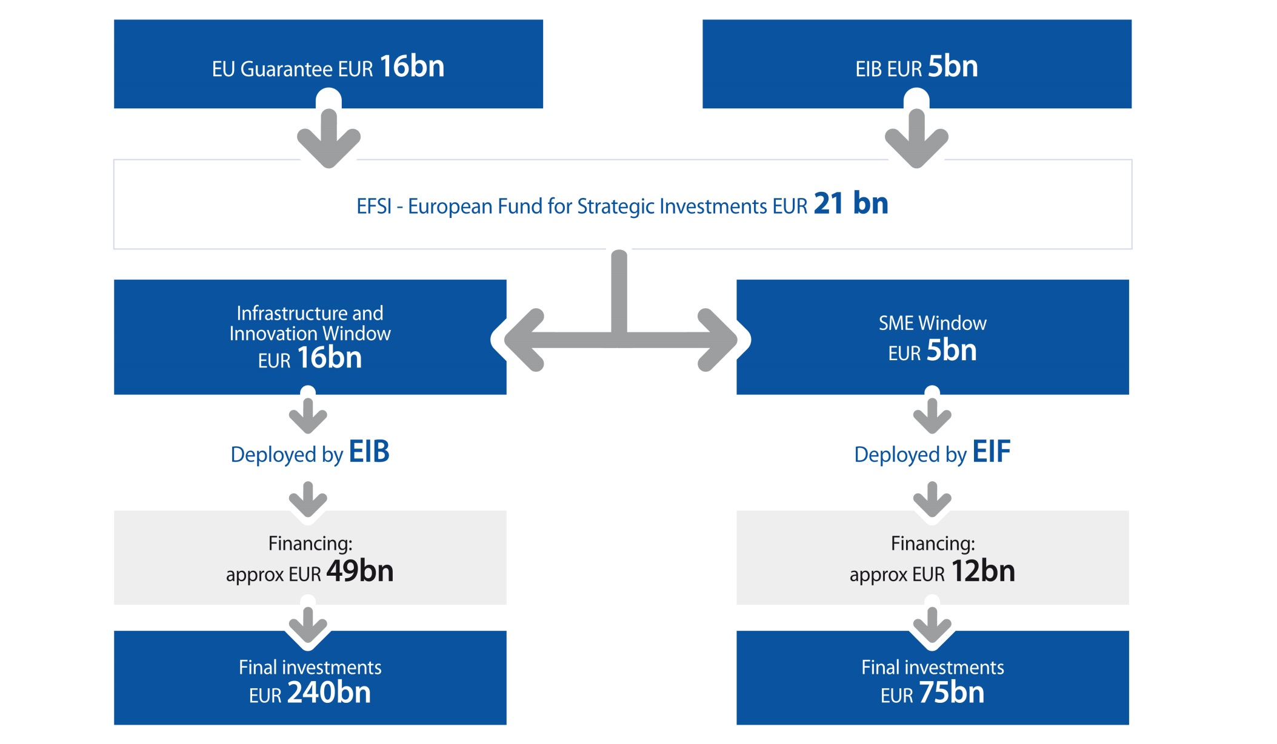
European Fund for Strategic Investments (EFSI)

Slide 5
Making a difference
Additionality – our value added
Address market failures or sub-optimal investment situations
Finance operations not possible to same extent without EFSI-backing
Absorb part of the risk to trigger additional investments
Impact
Attracting other sources of finance
Maximising growth
Supporting employment creation and retention

Slide 6
Key areas
Targeting strategic investment by public and private entities
Infrastructure, including transport, energy and digital
Innovation: Education and training, health, research, development
Renewable energy: Expansion of renewable energy generation and support of energy and resource efficiency
Environment: Projects in the environmental, urban development and social fields
SMEs and midcaps: Financing support through local partner banks and institutions

Slide 7
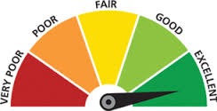
EFSI Scoreboard
EFSI Scoreboard – Key Components
Pillar 1:
Pillar 2:
Pillar 3:
Pillar 4:
Contribution to
EFSI objectives
EFSI general objectives
EFSI key policy objectives
Quality of the
Project
Sustainable
growth
Sustainability
Employment
Technical and
Financial
Contribution
Financial contribution
Facilitation
Advice
Complementary Indicators
Macro-economic indicators
Multiplier effect
Finance mobilised
Cooperation
+
+
+
EFSI Scoreboard: A decision-making aide for the IC
Anchored in EFSI Regulation
Pillars are evaluated independently (no accumulated score)

Slide 8
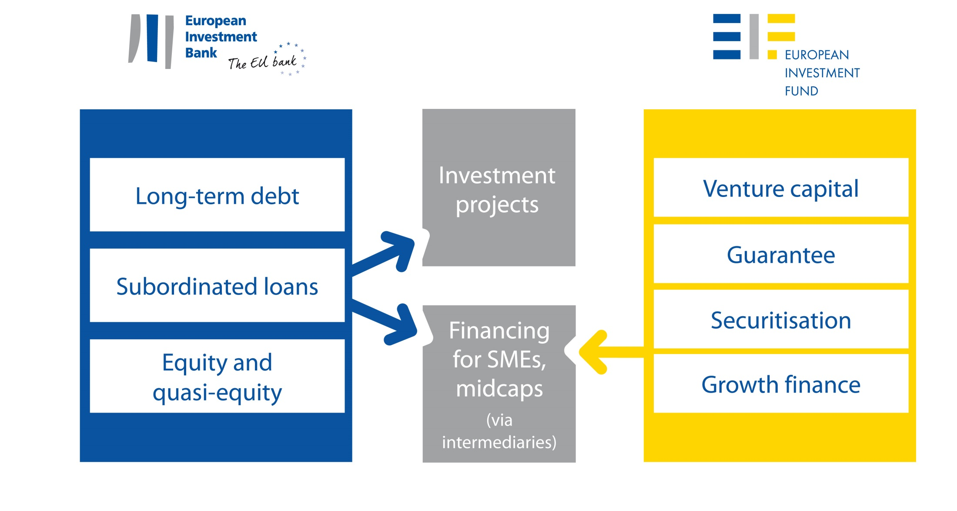
With targeted products
Continuously adapted to market needs

Slide 9
Multiplier
Internal Multiplier
x
External
Multiplier
=
EFSI
Multiplier
Relation between
EIB Loan / Equity amount
and
EFSI Contribution
Relation between
Total Investment
and
EIB Loan / Equity amount
Relation between
Total Investment
and
EFSI Contribution

Slide 10
EIB Group operations under EFSI
EIB Board of Directors approved more than 40 operations
Total EFSI financing amount of more than EUR 5.5bn
13 operations approved by the European Commission
Total signatures at EUR 450m, incl. EUR 125m equity type
EFSI multiplier can only be calculated at the end of the investment period, anticipated multiplier effect of EIB Board approved transitional operations is close to target of 15
Under der SME Window, the EIF is expected to sign 88 operations with a total financing volume of around EUR 1.7bn.
In total it is expected that the EIB Group will mobilise more than 35bn already in 2015 under the EFSI programme.

Slide 11
Thank you!

