Slide 1
Investment Plan for Europe: Closing the Investment Gap
Joint conference of the European Commission and the European Investment Bank
16th December, 2015
Jean-Marc MARTIN

Slide 2
Content
Brief introduction to EIB
Overview of EFSI’s structure and opportunities
16/12/2015 European Investment Bank Group

Slide 3
The EIB Group
Provides finance and expertise
for sound and sustainable investment projects
Specialist provider of risk finance to benefit innovative SMEs
16/12/2015 European Investment Bank Group

Slide 4
The EIB Group: a brief introduction
Largest multilateral lender and borrower in the world
Raising funds on the international capital markets
Pass on favorable borrowing conditions to clients
Some 440 projects each year in over 160 countries
Headquartered in Luxembourg and 30 local offices
Around 2 400 staff:
Finance professionals, engineers, sector economists and socio-environmental experts
More than 50 years of experience in financing projects
16/12/2015 European Investment Bank Group

Slide 5
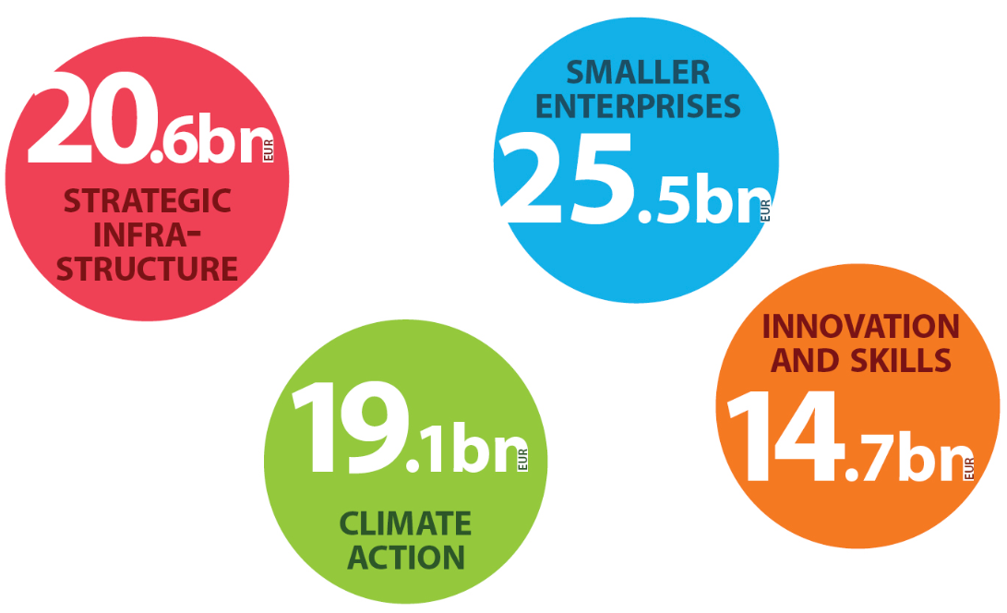
Priorities
16/12/2015 European Investment Bank Group

Slide 6
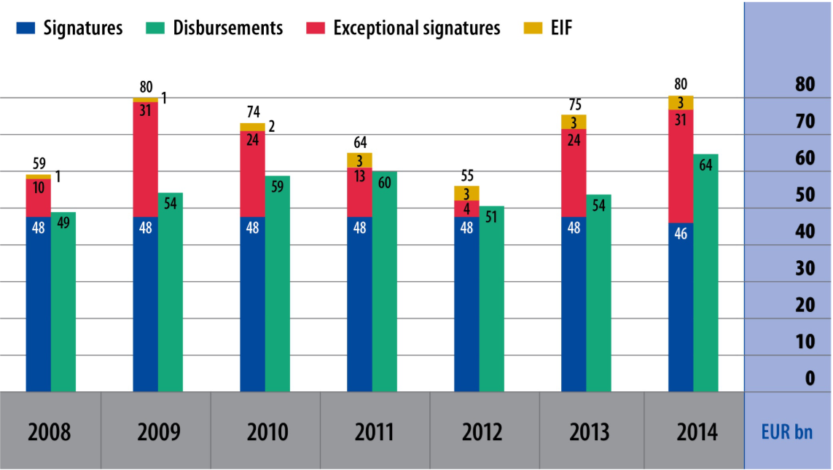
A Strong Response to the Crisis
16/12/2015 European Investment Bank Group

Slide 7
Our Products
We help catalyse investment
LENDING | BLENDING | ADVISING
Loans But also: Guarantees and Risk Sharing Equity participation | Combining EIB finance with EU budget Higher risk projects for innovation (RSFF / InnovFin) | Prepare & implement projects (JASPERS) Support for public / private partnerships (EPEC) InnovFin Advisory
Attracting FUNDING for long-term growth
16/12/2015 European Investment Bank Group

Slide 8
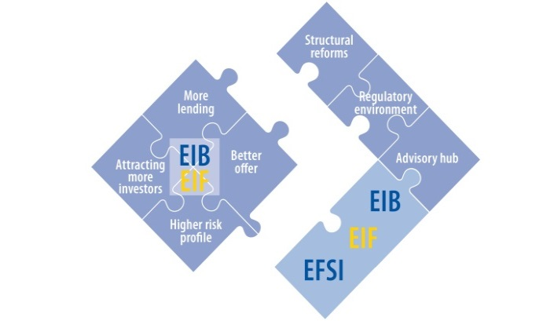
Overview of EFSI: structure and opportunities
The Investment Plan for Europe consists of three strands:
Improved investment environment: regulatory and structural reforms at EU and national levels for predictability, removing obstacles, aiming at a friendlier investment environment
Making finance reach the real economy: stepped-up technical assistance / advisory by establishing European Investment Advisory Hub (EIAH) in EIB and by EC facilitating a project directory
Mobilizing finance for investment: The EFSI, via EIB, to better address the current shortage of (higher) risk-financing in EU
Aim: to mobilize at least €315 billion in investment across the EU
16/12/2015 European Investment Bank Group

Slide 9
The Advisory Hub in the Investment Plan
Investment Plan for Europe
Mobilize EUR 315bn of additional financing
…through the European Fund for Strategic Investments (EFSI)
Support investment in the real economy
…through the European Investment Advisory Hub and the European Investment Project Portal
Create an investment friendly environment
…through improvements of the European regulatory environment
16/12/2015 European Investment Bank Group

Slide 10
European Investment Advisory Hub (EIAH)
Project promoters
Public authorities
Member States
Private sector
Web content + Web portal + Help Desk team
European Investment Advisory Hub (EIAH)
Managed by EIB in partnership with EC
EIB’s existing advisory programmes and activities
Additional advisory and technical assistance
EIAH’s partner institutions’ expertise
Project support (JASPERS, project preparation and implementation support)
Financial instruments (fi-compass, bilateral services for MAs)
Access to finance (InnovFin Advisory, EPEC, NPST)
New investment support also in areas relevant to the scope of EFSI (could be delivered by EIB advisory or operational teams)
Identification of needs as they arise
Network of institutions incl. EIB Group, EC, National Promotional Banks, etc.
Integrated collaboration model
16/12/2015 European Investment Bank Group 10

Slide 11
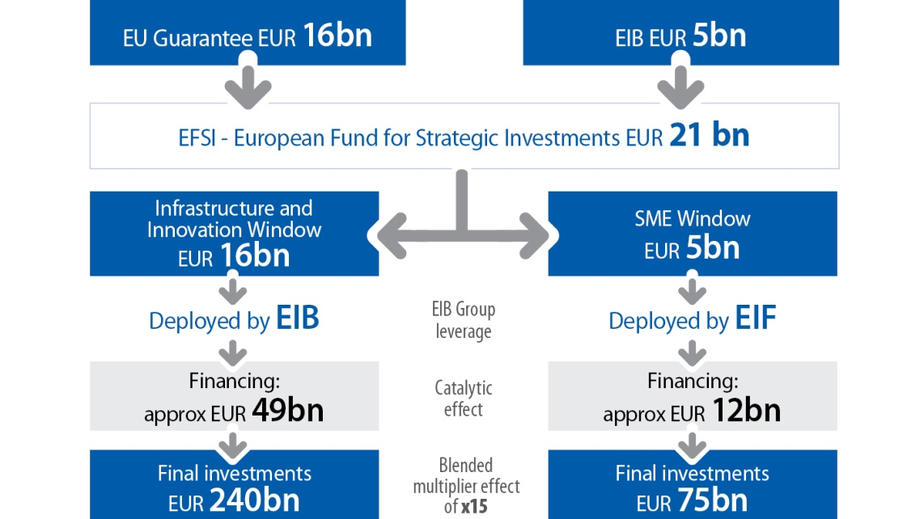
Overview: Contractual setup
European Fund for Strategic Investments (EFSI)
EFSI is NOT a fund or a separate legal entity
It is a contractual arrangement between EC & EIB Group.
EFSI consists of:
EUR 16bn EC guarantee in favour of EIB
EUR 5bn capital contribution by EIB
Target of generating EUR 315bn investment in 3 yrs.
All operations are EIB Group operations
16/12/2015 European Investment Bank Group 11

Slide 12
Overview: Timeline and investment period
Key milestones:
2015
2016
2017
2018
2019
2020
4 July
4 July
4 July
30 June
Entry into force of EFSI Regulation
Third anniversary of signing the EFSI Regulation
1st deadline for signature of EFSI operations
Deadline for approval of EFSI Operations
2nd deadline for signature of EFSI Operations
Investment period to achieve EUR 315 bn of total investments
“Extended” investment period
EFSI Operations to target EUR 315 bn of total investment by 2018.
Investment Period extends until 30 June 2020.
16/12/2015 European Investment Bank Group

Slide 13
Key messages
Impact-oriented operations: Objective to maximise economic impact in EU through increased investments
Flexible, diverse products: Adapted to client’s needs
Risk-absorbing to trigger investments with higher risk profile (additionality), but economically and technically viable (bankability)
Eligibility criteria mostly defined in terms of sectors
Maximising private finance / capital
All 28 MS coverage (and cross border)
Focus on employment creation and retention
Application for EIB loan directly to EIB / EIB partner institution, no separate project list / route via authority or government
16/12/2015 European Investment Bank Group 13

Slide 14
EIB EFSI ‘Products’
SOURCES
OF FUNDING
TYPICAL PRODUCTS OFFERED
FINAL RECIPIENTS AND TYPICAL PROJECTS
The Fund serves as credit protection for new EIB activities
Other investors join in on a project basis
European Fund for Strategic Investments
Long-term senior debt for higher risk projects
Transport infra
Long-term
investment funds
Broadband infra
Energy infra
Subordinated loans
Innovation
Energy Resource efficiency
Research
Renewable energy
Equity and quasi-equity
SMEs
Education
Continuously under development and adapted to market needs.
Also, increased capacity through EIF.
16/12/2015 European Investment Bank Group 14

Slide 15
Eligible sectors
Wide eligibility criteria - Operations consistent with Union policies that support any of the following general objectives:
development of infrastructure including in transport, telecommunications, digital and energy infrastructure; infrastructure projects in the environment, natural resources, urban development and social fields
research and development and innovation
investment in education and training, health, information and communications technology
develop and modernize the energy sector, renewable energy, security of energy supply and energy and resource efficiency;
financial support for mid-cap companies and SMEs.
EIB present appropriate projects to the EFSI Investment Committee that approves all projects’ EFSI eligibility.
16/12/2015 European Investment Bank Group

Slide 16
Eligible operations
Commercially sound
Economically and technically viable
Added value (additionality)
Investments boosting employment and growth
Bank intermediation is possible
Pricing commensurate with the risk – no subsidy element
Typically higher risk profile than normal EIB’s normal operations
Risk-absorbing products to foster the implementation of additional projects and to support the development of SMEs and MidCaps
16/12/2015 European Investment Bank Group

Slide 17
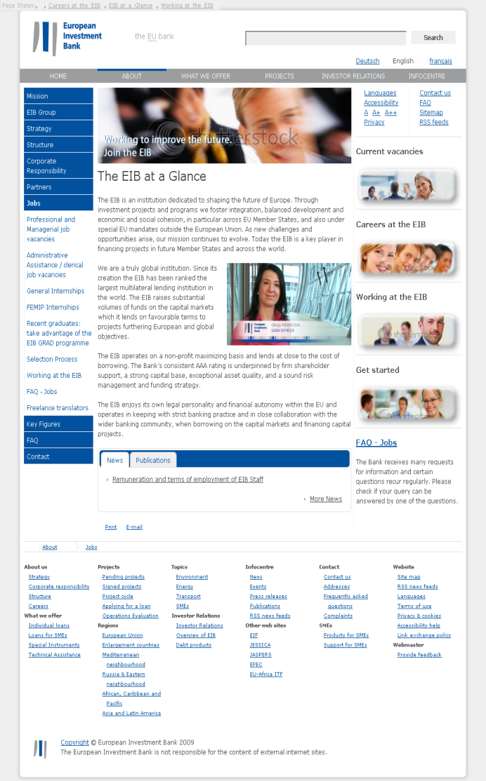
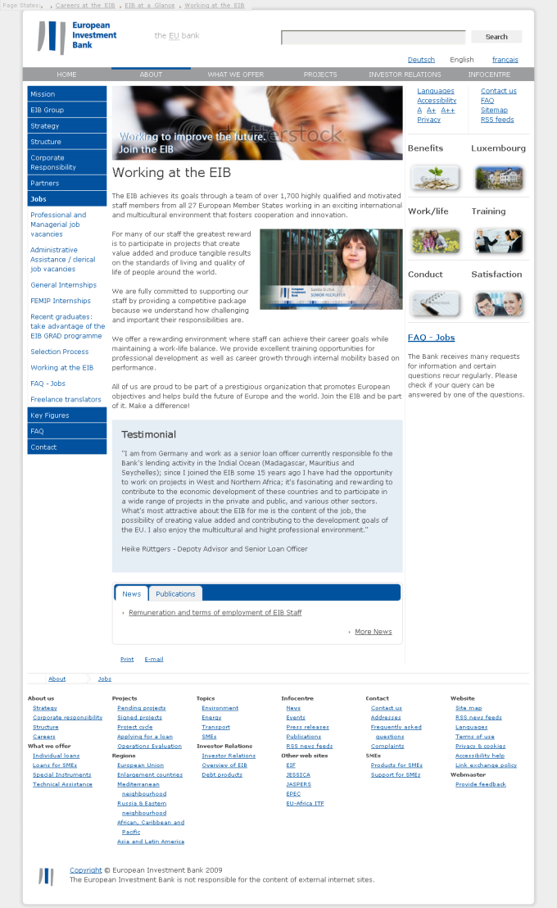
Contact Information
Jean-Marc MARTIN
Deputy Head of Division
Public Sector Lending Operations
Croatia, Slovenia, & Western Balkans
martinjm@eib.org
98-100 boulevard Konrad Adenauer
L-2950 Luxembourg
Tel: +352 43 791
www.eib.org
www.eib.org/eiah
www.eif.org
HVALA!
Notes:
17

